Slide 1

MAJOR PROJECT PRESENTATION ON DUAL AUTHENTICATION FIREWALL
MAHANT BACHITTAR SINGH COLLEGE OF ENGINEERING & TECHNOLOGY
DEPARTMENT OF INFORMATION TECHNOLOGY
Submitted By:
Royal Singh(603/16)
Harpreet Singh(604/16)
Sandeep Singh(607/16)
Amrik Singh(615/16)
Adnan Shabir(620/15)
Guided By:
Mr. Rakesh Sambyal
(Assistant Professor)

Slide 2
Contents
Introduction
Types Of Firewall
Firewall Techniques
Existing Software Based Firewalls
Dual Authentication Firewall
Existing Vs. Dual Authentication Firewall
Modules
Data Flow Diagrams
Technology Used
References

Slide 3
Introduction to Firewall
System to prevent unauthorized access to a network
Helps to block unwanted traffic
Provides safety barrier between networks
Useful for large organizations
Access control rules are based on:
IP address
Domain name
Port number
Payload(Data)

Slide 5
Types of Firewall
Host based firewall
Network based firewall

Slide 6
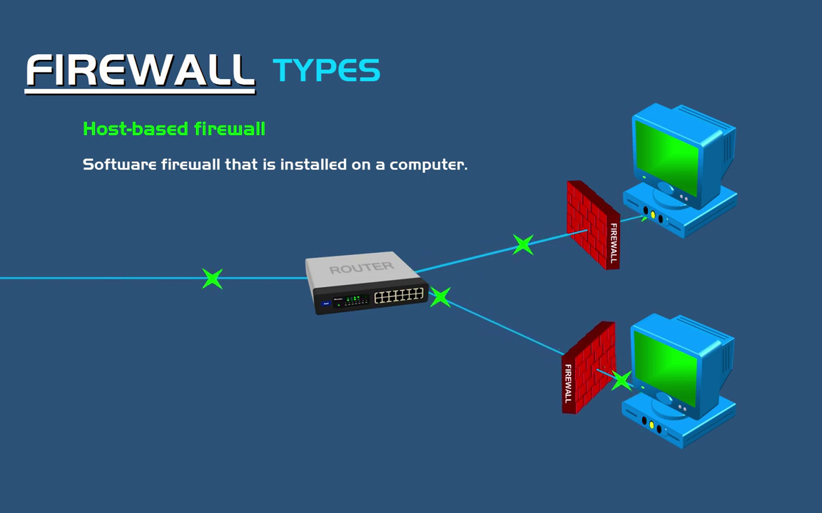

Slide 7
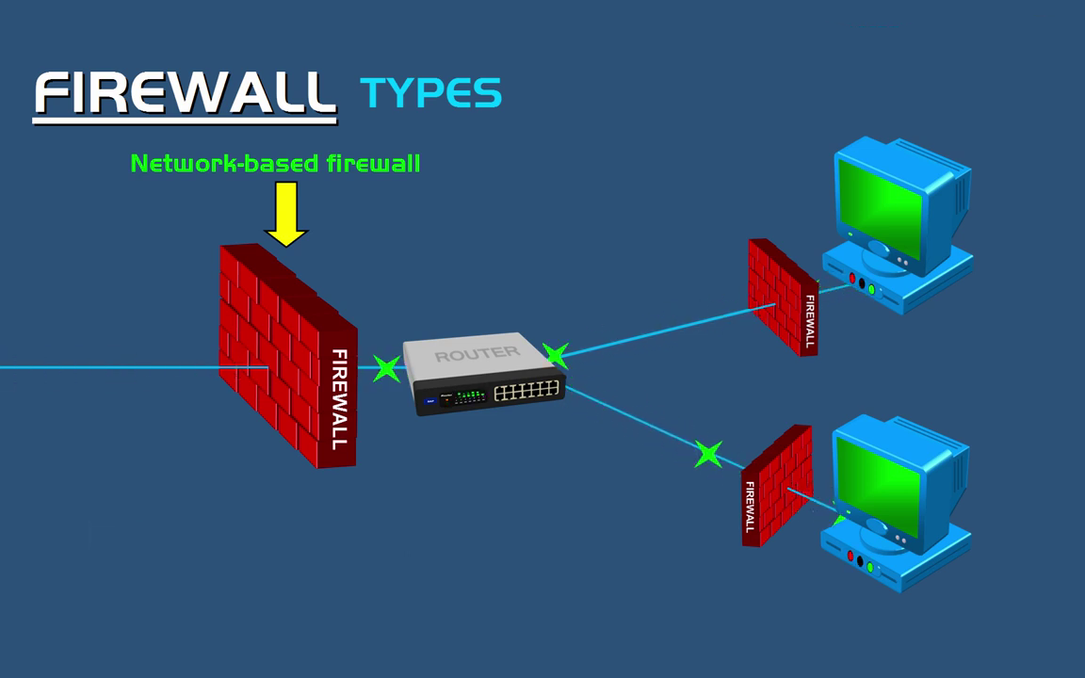

Slide 8
Firewall Techniques
Packet filtering
Application level gateways
Hybrid
Stateful inspection

Slide 9
Existing Software Based firewall
ModSecurity
WebCastellum
Profense
Esapi WAF

Slide 10
Dual Authentication Firewall
Server based Firewall
Access control is based some type of IP Address
Provide connection to only specific clients
Provide further checks on clients
Stores IP Address of unauthorized clients
Blocks connection attempts of unauthorized clients

Slide 11
Existing Vs. Dual Authentication Firewall
Different technique of providing access to clients
Provides an option of access to only specific clients
Enhanced security with further checks
Blocks connection attempt of some clients
Reduce level of penetration

Slide 12
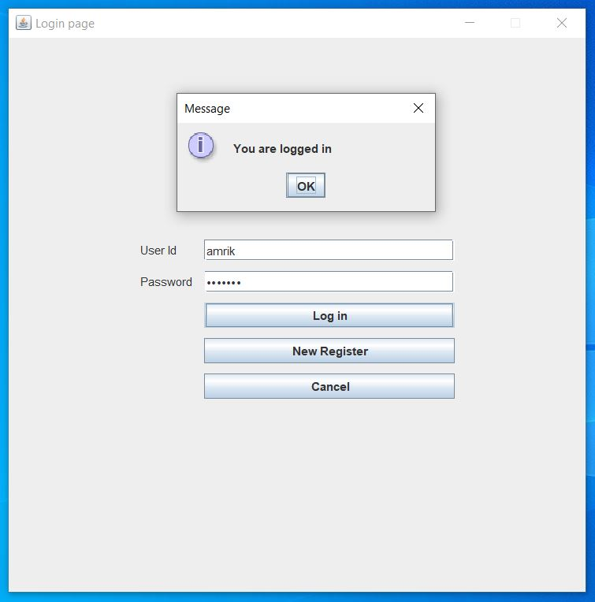
Modules
User authentication

Slide 13
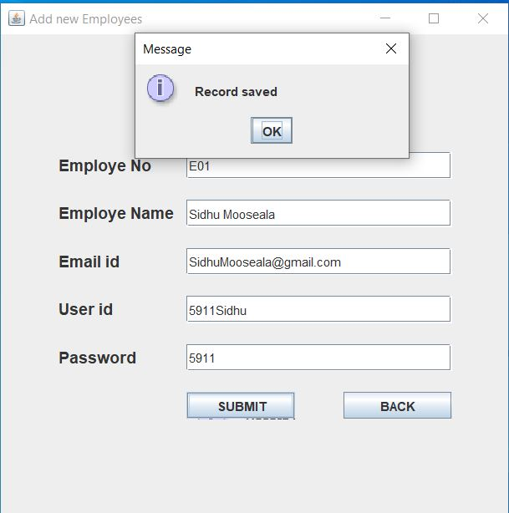
New Register

Slide 14
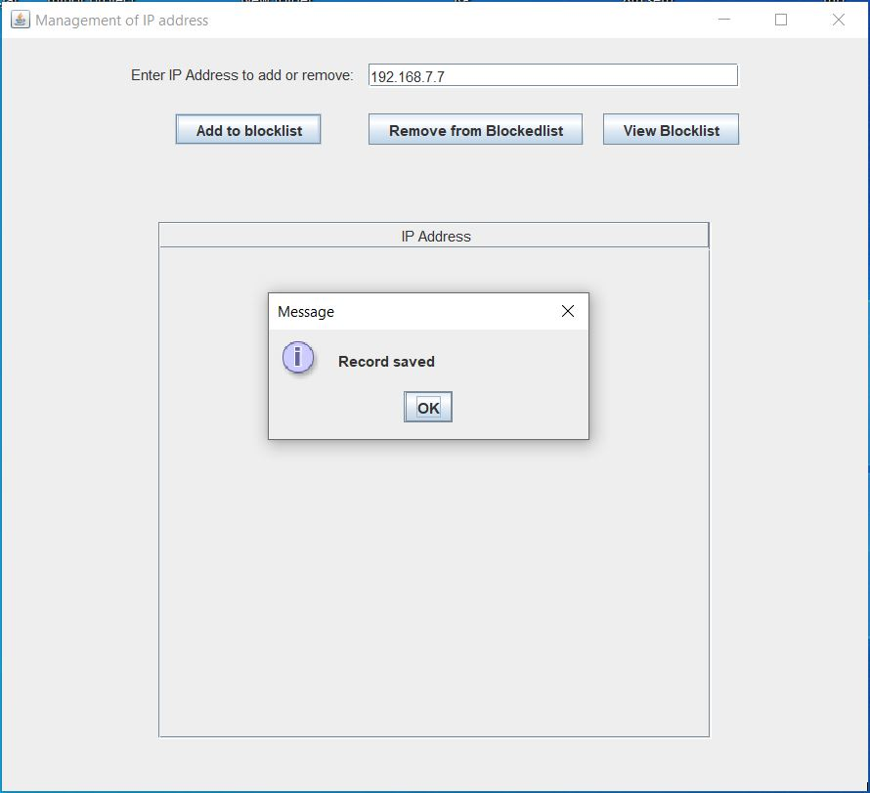
Add a client to block list

Slide 15
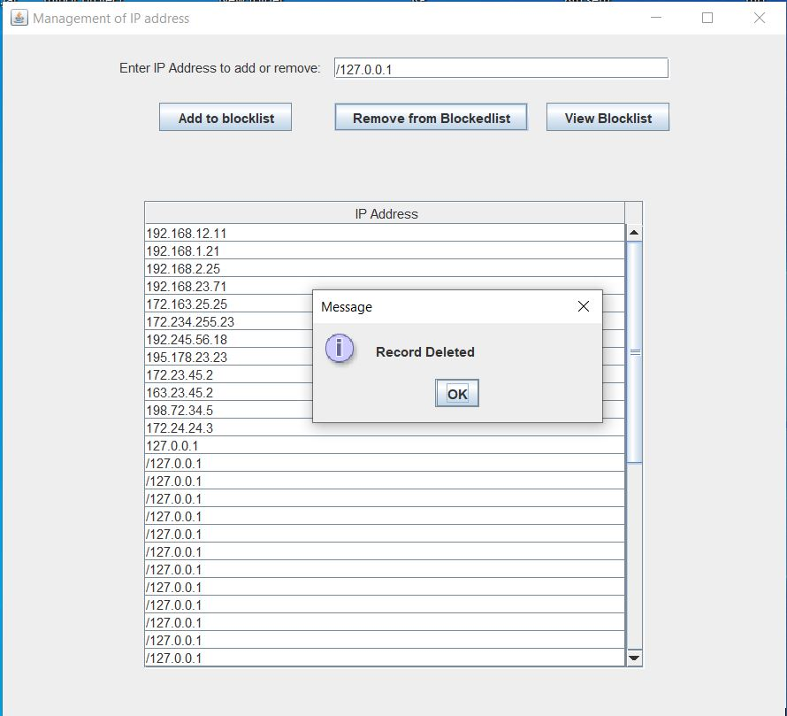
Remove a client from block list

Slide 16
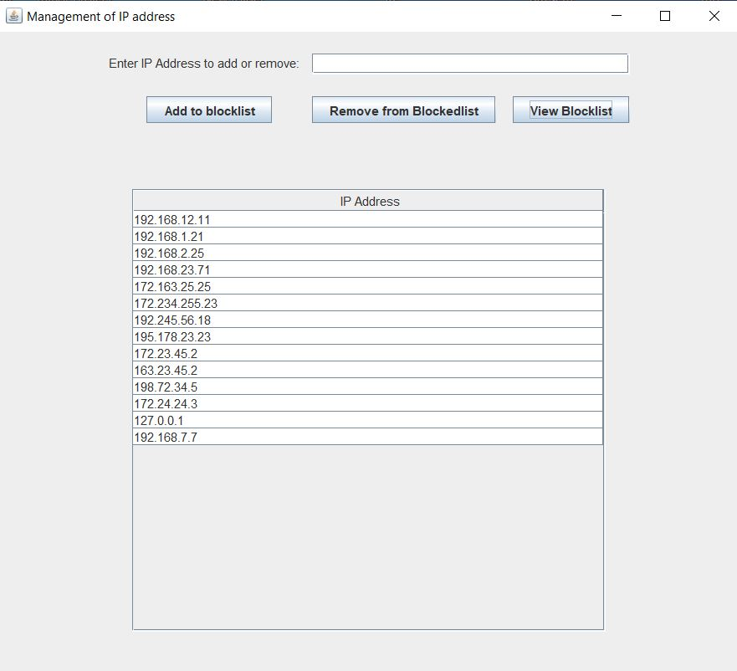
View block list

Slide 17
Data Flow Diagrams
Level 0 DFD
URL/IP
Firewall
Client
Get Rules
Rules
Response

Slide 18
Level 1 DFD
Add URL/IP
To Add URL/IP
Manage
Console
Admin
Manages
Remove URL/IP
To Remove URL/IP

Slide 19
Coding libraries used:
Database tools:
UcanaccessDriver
DriverManager class
Connection class
Statement class
ResultSet class
Server side code tools:
ServerSocket and Socket class
Thread class
InetAddress class
Printwriter class

Slide 20
InputStream class
InputStreamReader class
BufferReader class
User Interface:
GridBagLayout Class
GridBagLayoutConstraints class
Jframe, JButton, JTextField, JPasswordField, JTable class
Label class
Jpanel, JScrollPane class
DefaultTableModel class

Slide 21
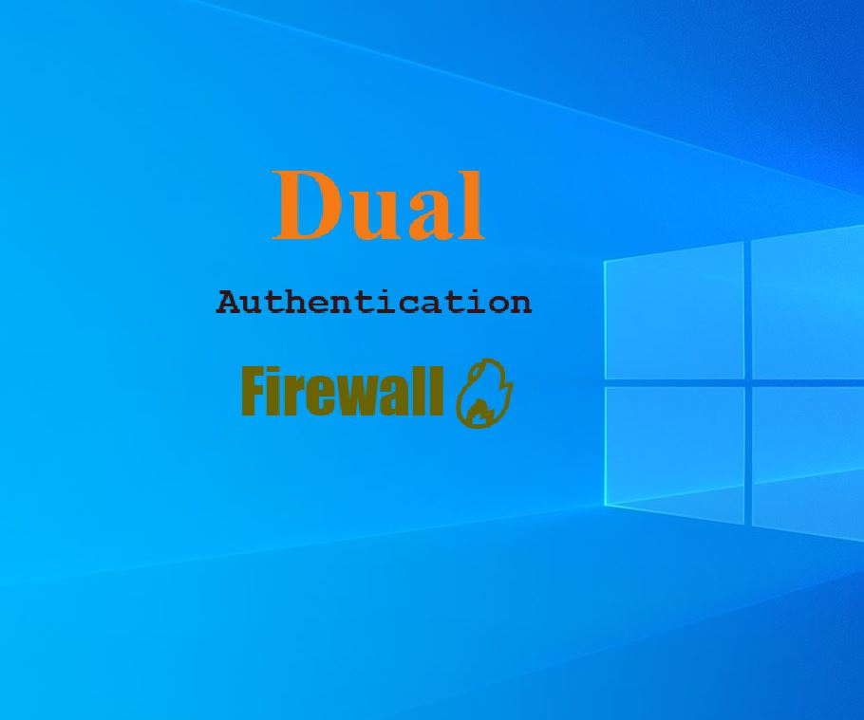
Snapshots:
Popup Screen

Slide 22
Login and registration

Slide 23
View Block List and Add or Remove IP Address:

Slide 25
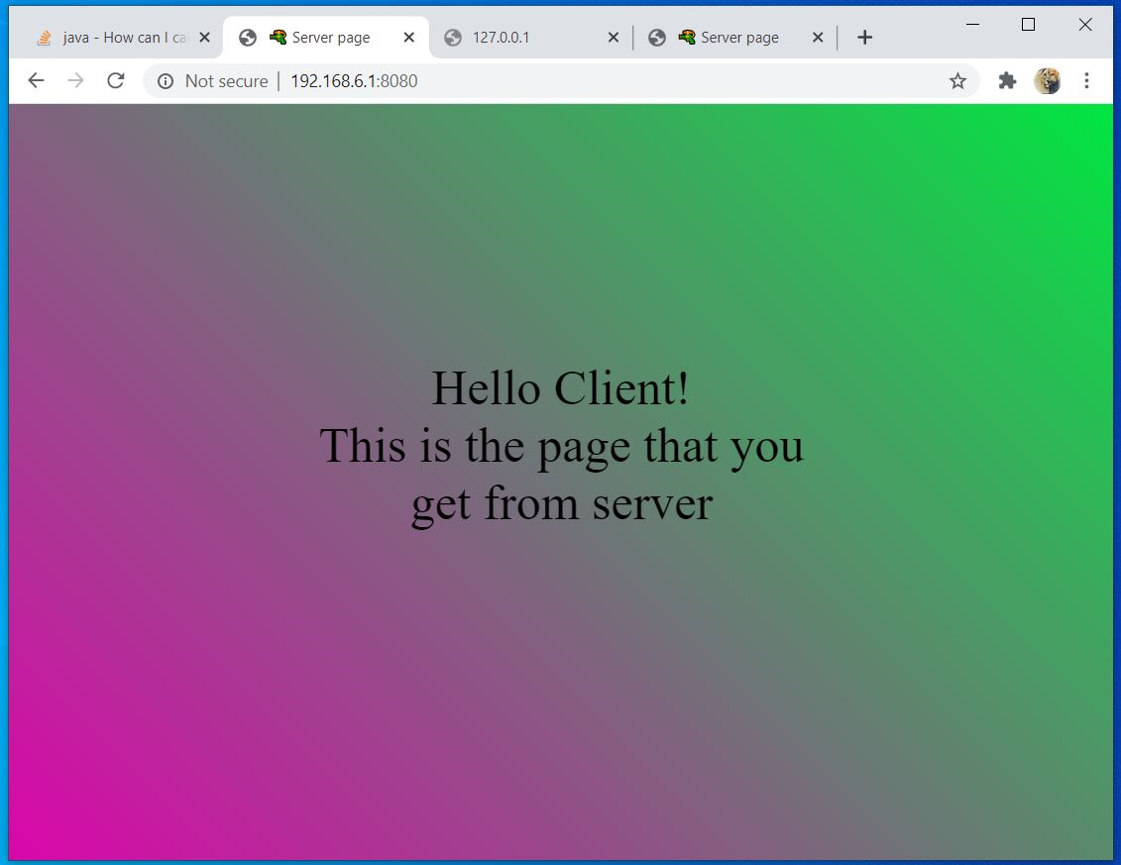
client request and response from server

Slide 26
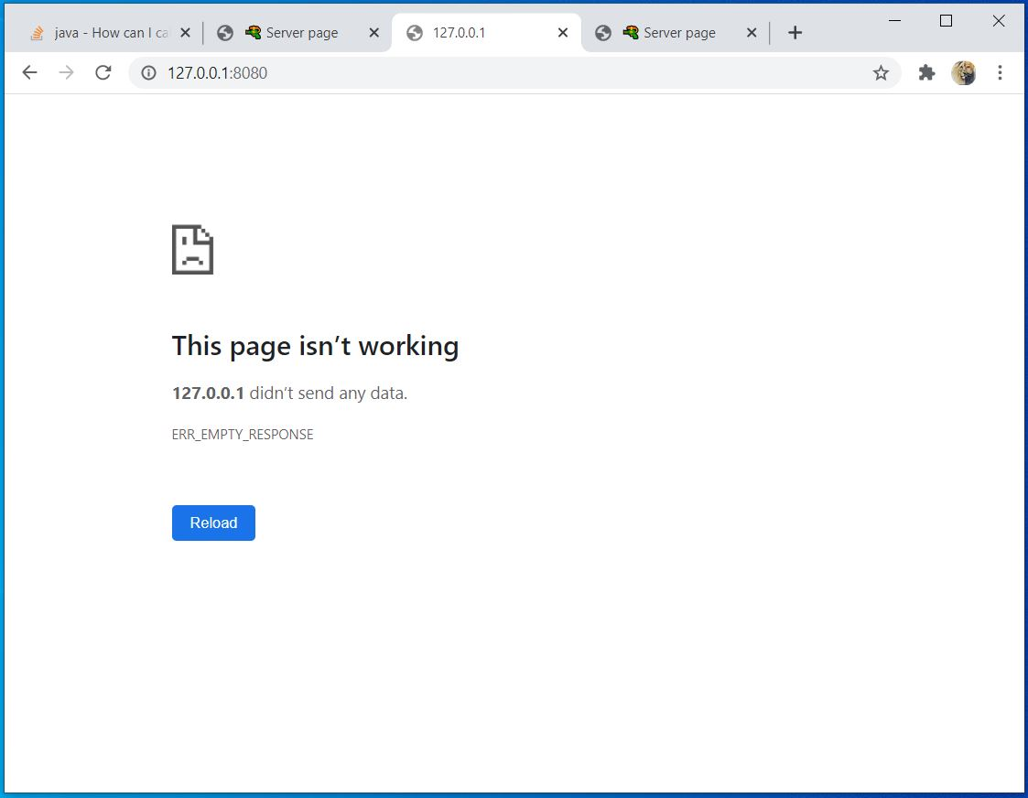

Slide 27
Advantages:
Provides dual authentication
Fast and secure
Can be installed on servers of organisations to prevent unauthorized access
Provides an option for user to add or remove different IP addresses

Slide 28
Future Scope:
Security cover can be increased by using some other libraries
Extendable to web servers to protect websites or web applications
New security policies can be integrated to make it Hybrid

Slide 29
Technologies Used
Software Requirements:
Operating System: Microsoft Windows 7/8 or Above
Frontend: jdk-14.0.2.
Development Framework: Eclipse IDE
Client Side Requirement: Java Development kit
Database: MS Access
Hardware Requirements:
Intel Pentium processor or more
256 MB RAM or more
80 GB Hard Disk or More

Slide 30
References:
[1] https://en.wikipedia.org/wiki/Firewall_(computing)
[2] https://www.geeksforgeeks.org/introduction-of-firewall-in-computer-network
[3] https://www.compuquip.com/blog/the-different-types-of-firewall-architectures
[4] https://www.geeksforgeeks.org/types-of-firewall-and-possible-attacks
[5] https://searchsecurity.techtarget.com/feature/The-five-different-types-of-firewalls
[6] https://en.wikipedia.org/wiki/ModSecurity
[7]The Complete Reference by Herbert Schildt
[8]Java Network Programming by Elliote Rusty Harold

Slide 31
THANK YOU

